Slide 1
Higher Education Funding Allocation Model
September 13, 2024

Slide 2
Today’s Discussion
HB20-1366 Higher Education Allocation Model Legislation Overview
Higher Education Allocation Model Operation Discussion
Higher Education Allocation Model Demonstration
Higher Education Allocation Model Analysis

Slide 3
Legislative Declaration
Increase the number of Coloradans who have earned a high-quality postsecondary credential. – C.R.S. 23-18-301 (1)(d)
Increase the rate of participation of low-income and currently underrepresented minority students. – C.R.S. 23-18-301 (1)(f)
Incentivize state institutions of higher education to achieve the policy goals adopted by the General Assembly and the CCHE Master Plan. – C.R.S. 23-18-301 (1)(g)

Slide 4
Legislative Declaration – continued
To ensure tax dollars are being used to achieve state goals, higher education must be funded in a manner that is transparent and understandable. – C.R.S. 23-18-301 (2)(a)
To accomplish these state goals, must establish performance metrics that are consistent, predictable, and focused on improved performance. – C.R.S. 23-18-301 (2)(b)

Slide 5
How Do IHEs Receive State Operating Support?
C.R.S. 23-18-303.5 outlines the use of fee-for-service (FFS) contracts to support institutions of higher education for the delivery of higher education services for the benefit of the state and its residents.
FFS contracts provide appropriated state support through the funding formula, PLUS any Special Education Program support, PLUS any limited purpose funding associated with specific bills LESS any funding appropriated through College Opportunity Fund (COF) student stipends.

Slide 6
CO Higher Education Funding Allocation Model
House Bill 20-1366
Reps. Esgar and McCluskie
Sens. Zenzinger and Rankin
New funding model began in 2021-22
State support based on 3 components:
Ongoing additional funding (Step 1);
Performance funding (Step 2); and
Temporary additional funding (Step 3)
This total funding is disaggregated in the Long Bill each year between COF stipends (based on per credit hour cost x est. resident students served) and FFS reimbursement.

Slide 7
Step 1
Ongoing Additional Funding
Prior to calculating performance funding, the Commission may recommend additional funding to add to the base for the following purposes:
Progress toward master plan goals, including addressing base funding disparities or funding priorities not addressed through performance funding
Additional costs associated with educating resident first-gen undergrad students
Recommendations should be focused on broad institutional, systemwide, or state policy goals.
FY2022 Model - $40.8M in NEW state support
FY2023 Model - $50.0M in NEW state support
FY2024 Model - $27.0M in NEW state support
FY2025 Model - $7.3M in NEW state support
Limited to three rural-serving institutions

Slide 8
Step 2
Performance Funding
After calculating funding recommendations addressing base building, the Commission shall calculate performance funding for each Governing Board based on the rate of change over time on each performance metric.
Even though this is referred to as “Step 2,” this portion of the formula is the main tool to distribute funds to institutions, including:
Previous year’s Step 1 funds,
Existing base funding, and
Any new funding for common policies, including salary, HLD, and other mandatory costs.
FY2022 Model - $31.4M in NEW state support
4.7% increase over FY2021
Additional $8.5M in NEW funding to SEPs, LDCs, ATCs
FY2023 Model - $44.2M in NEW state support
6.0% increase over FY2022
Additional $11.1M in NEW funding to SEPs, LDCs, ATCs
FY2024 Model - $68.2M in NEW state support
8.3% increase over FY2023
Additional $17.7M in NEW funding to SEPs, LDCs, ATCs
FY2025 Model - $85.0M in NEW state support
9.3% increase over FY2023
Additional $31.9M in NEW funding to SEPs, LDCs, ATCs
Including $10.86M for Medicaid match at CU Anschutz

Slide 9
Step 3
Temp Additional Funding
After calculating ongoing additional and performance funding, the Commission may recommend additional temporary funding to make progress toward master plan goals or for any other purpose.
These funds are not base building and are, therefore, not incorporated into Step 2 in future fiscal years.
No funding has been recommended through Step 3 since the implementation of the allocation model.

Slide 10
Funding Allocation Formula Overview
Current performance funding model utilizes eight (8) metrics aligned with the 2020 Master Plan.
Each performance metric is weighted to determine the relative influence on the funding recommendations.
Each metric measures performance over time within each Governing Board (GB). 4 most recent years of data 3 oldest years of data
This rate of change is then multiplied by the GB’s role and mission share based on the share of total appropriation in previous fiscal year to get “GB R&M adj share.”
Sum GB R&M adjusted shares to determine “Total R&M adj. share.”
Current Performance Funding Metrics
Resident student full-time enrollment (FTE) [SURDS];
Resident first-generation UG student headcount [SURDS];
Credential completion [SURDS];
Resident Pell-eligible UG student population share [SURDS];
Resident underrepresented minority UG student population share [SURDS];
Retention rate [IPEDS];
100% Graduation rate [IPEDS]; and
150% Graduation rate [IPEDS].

Slide 11
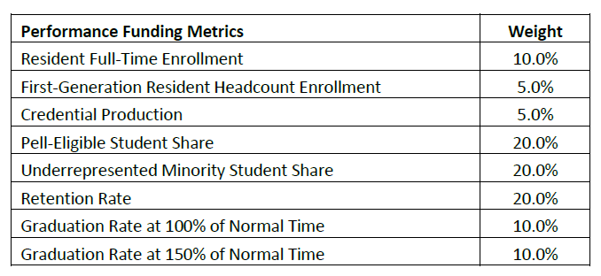
Funding Allocation Formula Overview – Weights

Slide 12
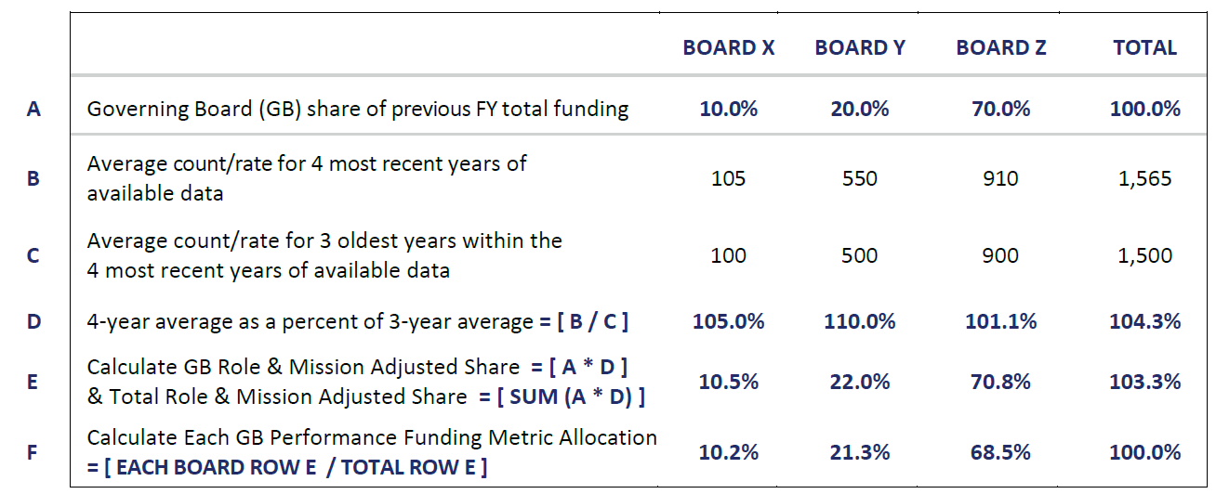
Funding Allocation Formula Overview - Operation

Slide 13
Funding Allocation Formula Overview - Demonstration

Slide 14
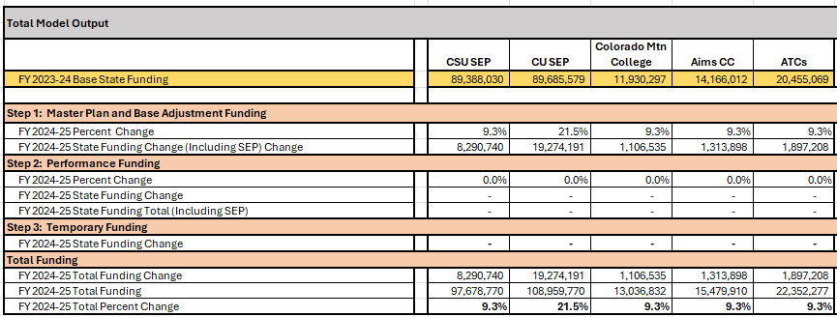
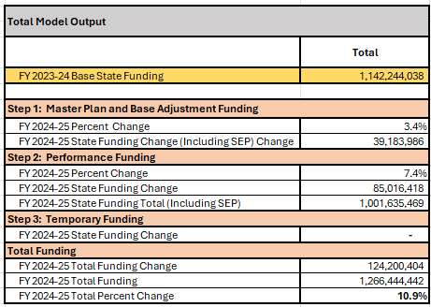
Funding Allocation Formula Overview – Demonstration continued

Slide 15
Cumulative Percent Change in Governing Board Support Since FY2022

Slide 16
Cumulative Change in Governing Board Support Since FY2022

Slide 17
Performance Metric Changes Since 2021-22

Slide 18
Share of State Operating Support – Statutory Performance Metrics Only

Slide 19
Thank You!
October 2024

