Slide 1
Fiscal Year 2025 Higher Education Funding Formula
Lauren Gilliland, Deputy Chief Financial Officer, CDHE
October 26, 2023

Slide 2
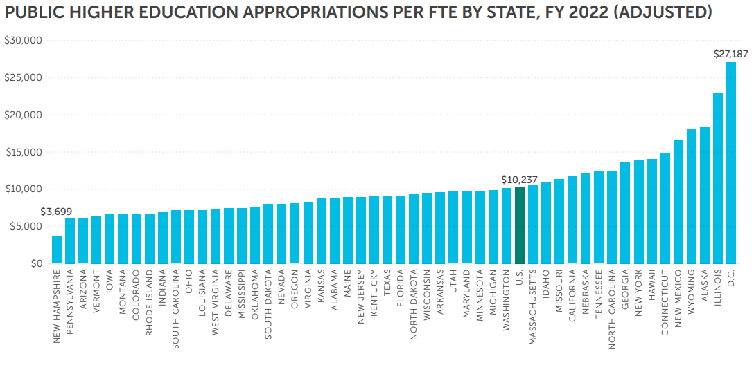
National Funding Context
Source: SHEEO State Higher Education Finance Report

Slide 3
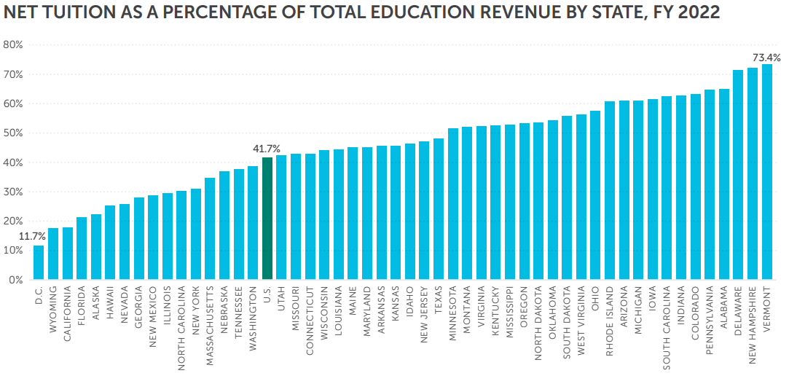
National Funding Context
Source: SHEEO State Higher Education Finance Report

Slide 4
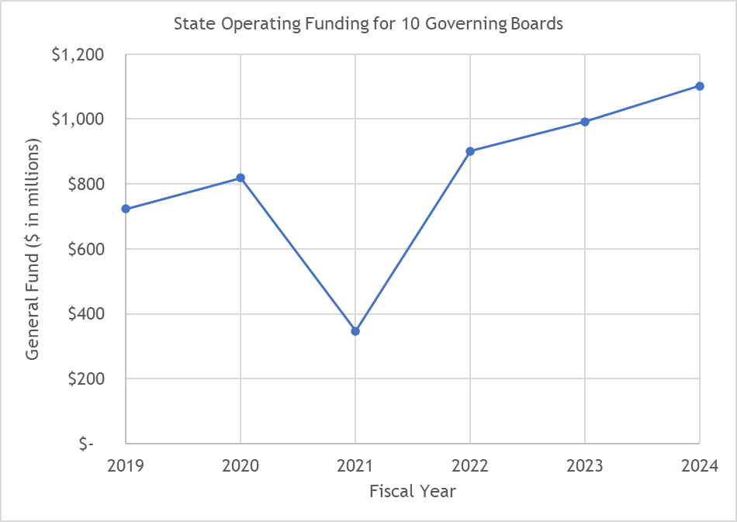
State Funding Context

Slide 5
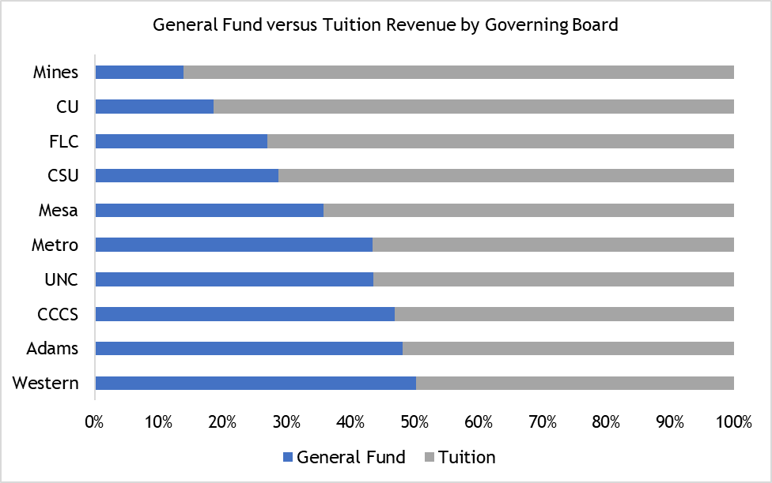
State Funding Context

Slide 6
CORE MINIMUM COSTS​
What are Core Minimum Costs?
Amount of funding needed to maintain current operations
How were Core Minimum Costs calculated for Fiscal Year 2025?
Salary increase of 3% consistent with COWINS ATB
HLD employer premium increase assumption of 5%
Other costs increased by 4.7%
Fiscal Year 2025 Core Minium Costs
$140 million
=
$96M personnel + $44M other
Notes:
12.8% of FY23 state funding
3.8% of FY23 total funding (state + tuition)

Slide 7
Colorado’s Performance-Based Funding Formula
Prior to 2014, base funding was historical and not formula-based.
H.B.14-1319 established the State’s first performance funding formula
H.B.20-1366 established the current performance-based funding formula
Greatly simplified the formula compared to the 2014 version
Still complex and can seem opaque
As established in H.B.20-1366, next revision of the PBF formula is scheduled for completion in November 2026.
Statute requires review every 5 years.

Slide 8
Colorado’s Performance-Based Funding Formula
In Fiscal Year 2023-24, the formula distributed $920 million to the state’s 10 public governing boards.
This represents an 11.5% increase over Fiscal Year 2022-23.
Of this $95M increase, $27M went through Step 1.
Specialty Education Programs (CU Med and CSU Vet), Local District Colleges (Aims and CMC), and Area Technical Colleges do not directly participate in the formula
Received proportional increases totaling $25 million.

Slide 9
Colorado’s Performance-Based Funding Formula
STEP 1
Flexible funding addressing base funding concerns or Master Plan goals recognizing the needs of specific populations.
STEP 2
Based on institutional progress in performance categories outlined in State statute, consistent with the previous Master Plan.
STEP 3
Flexible funding based on institutional needs, base funding concerns, specific institutional projects, or related to specific populations.
MASTER PLAN GOALS/BASE INEQUITIES
(BASE BUILDING)
PERFORMANCE (BASE)
ONE-TIME INITIATIVES

Slide 10
Master Plan Performance Categories STEP 2
Performance Metric | % Weight
Resident FTE Enrollment | 10%
Credential Production | 5%
Pell Eligible Enrollment | 20%
Race/Ethnicity Enrollment | 20%
Retention Rate | 20%
Graduation Rate (100% of time) | 10%
Graduation Rate (150% of time) | 10%
First Generation Enrollment | 5%
TOTAL | 100%

Slide 11
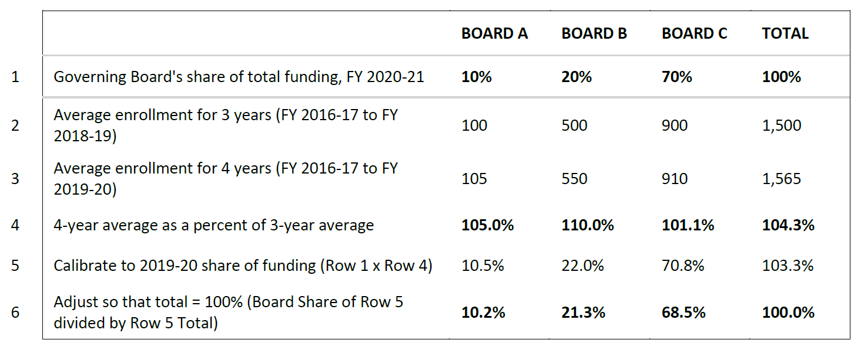
Colorado’s Performance-Based Funding Formula

Slide 12
CCHE Statutory Obligations
Fiscal Year 2025 Actions
Recommend weight structure for performance metrics in Step 2 of the formula.
Recommend the proportion of total funding flowing through Step 1, Step 2, and Step 3 of the formula.
Optional: Recommend a funding level and/or draft a statement on funding formula funding.

Slide 13
Examples of Previous Years’ Actions
Recommended stable weights on Step 2 performance metrics (same weights since Fiscal Year 2021-22)
Recommended all funding flow through Step 2 until core minimum costs met
Not recommended specific funding amount (Values-based letter sent to Governor in 2021)

Slide 14
Institution Performance on Step 2 Metrics

Slide 15
Fiscal Year 2024-25 Funding Scenarios

Slide 16
Commission Action Required
Recommend weight structure for performance metrics in Step 2 of the formula.
Recommend the proportion of total funding flowing through Step 1, Step 2, and Step 3 of the formula.
Optional: Recommend a funding level and/or draft a statement on funding formula funding.

Slide 17
Fiscal Year 2025 Higher Education Funding Formula
October 26, 2023

