Slide 2
Credentials are presented for consideration FROM any of these interested parties:
Credential holders (current or potential student)
Credential providers (industry group/trade association; training organization)
Credential “buyer”/hirer (e.g., individual business/employer)
Credential promoter/supporter (government entity such as CDE or state apprenticeship agency)
Other interested party (e.g., faculty in a specific academic program)
CDHE (credentials identified in consultation with GE Council as having high potential for alignment with transfer frameworks; these may be referred direct to CCCS or addressed in batches at a Fac2Fac-type conference)
Credentials are presented for consideration TO any of these entities:
CDHE, through a to-be-created portal or intake form (CDHE then routes to CCCS)
A CCCS institution (referred to CCCS for evaluation using existing/refined PLA processes)
Directly to CCCS through an existing/refined portal/intake form
To another IHE that uses its own processes for evaluation
To another IHE that refers presenter to CCCS

Slide 3
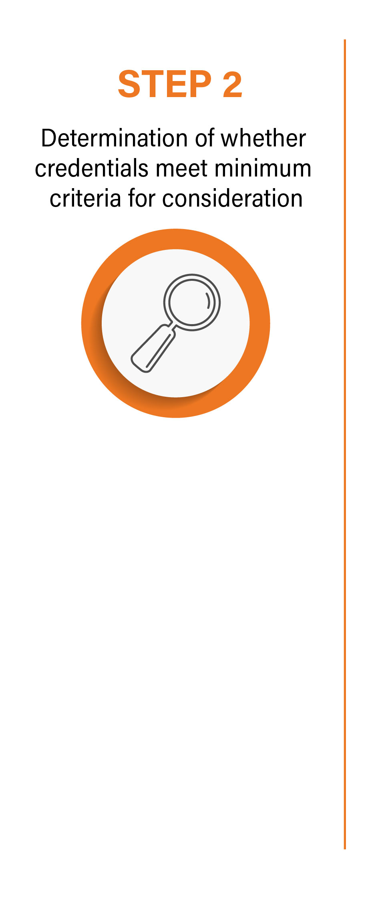
A to-be-developed portal/intake form will outline criteria and include a checklist to be completed by presenter
Criteria used will include alignment with National Skills Coalition criteria on quality non-degree credentials, which must be met for WBL to be considered for evaluation:
Is aligned to an occupation on a regional or statewide list of in-demand or critical occupations
Said occupation meets the living wage threshold for Colorado (statewide average)
Credential meets 2 out of the following 4 criteria:
Provider is accredited or credential is recognized by an accredited body
Credential is stackable into an existing degree or certificate program
Credential is traceable to competencies (valid) or to the provider (verified)
Credential is portable
WBL provider will also be encouraged to register with the ETPL (Eligible Training Provider List); in the future this may be required for consideration
✓ If credential meets minimum criteria proceed to Step 3
✗ If credential does not meet minimum criteria, communicate such to the presenter

Slide 4
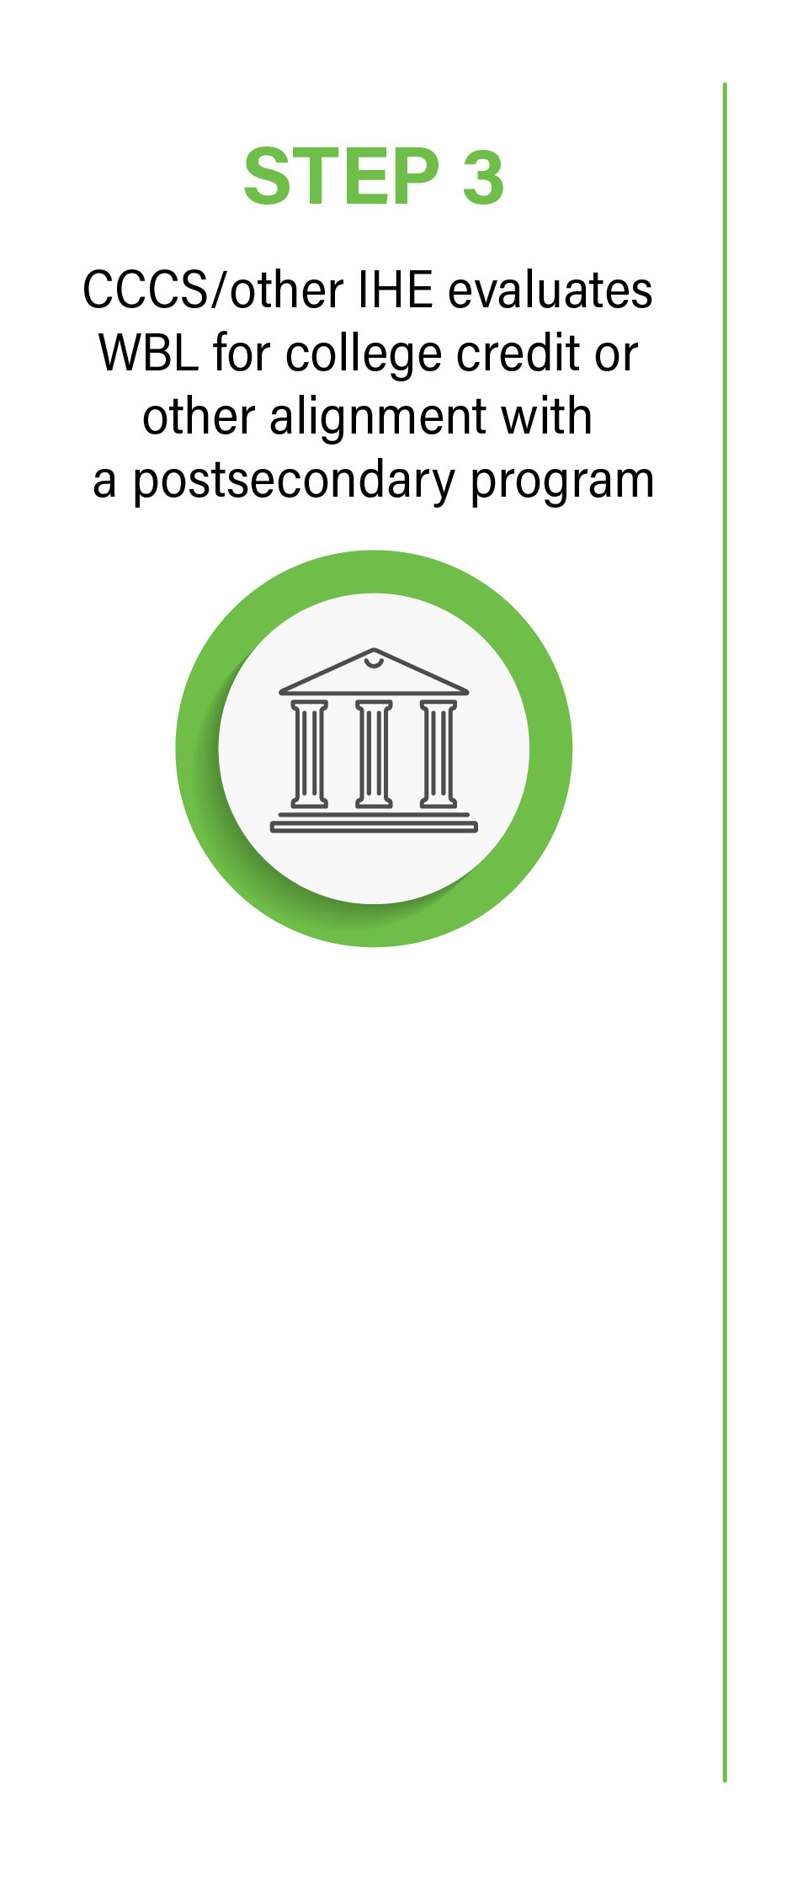
Possible outcomes: | Possible outcomes:
A. | Alignment with a specific GT Pathways category with recommendation to GE Council for consideration for statewide transfer | ✓ proceed to step 4
B. | For CCCS only, equivalency with a specific course that is part of a Statewide Transfer Articulation Agreement with recommendation to GE Council for consideration for statewide transfer | ✓ proceed to step 4
C. | Equivalency with another course or courses in the curriculum specific to the institution where the credential is presented (could be part of a degree program or a CTE program) – CCCS/other IHE will add to its own credit for prior learning (CPL) crosswalks – will not be part of statewide transfer but institutions could enter into articulation agreements with partners
D. | Partial alignment with GT Pathways (fulfills one or more content criteria or competencies) – CCCS or other IHE may identify other credentials that fulfill remaining elements, and/or work with a student to identify opportunities to acquire and demonstrate learning to fulfill remaining elements (these might be added into a crosswalk/working document of sorts)
E. | No credit awarded and no application toward program requirements
F. | For WBL that is referred from a four-year institution to CCCS, CCCS will document the outcome of the review and communicate to the student, along with options for how to apply recommended course credit or learning outcomes to a program within CCCS Note: CCCS will have a dry run of this process with 25 selected credentials evaluated during the Fall 2021 semester

Slide 5
If STEP 3 results in (a) or (b):
For GT Pathways recommendations, CCCS/other IHE submits proposal to CDHE using form to be created, similar to proposals to add institutional courses to GT Pathways
CDHE reviews and brings proposal to GE Council; proposal added to a list for statewide faculty review
CDHE holds (quarterly/semi-annual?) Fac2Fac-type conference to review proposals and make recommendations to GE Council regarding GT Pathways alignment; agenda will include:
Credentials that are nominated by an institution for inclusion in GT Pathways
Credentials that are nominated by CDHE for inclusion in GT Pathways based on market capture, connection to in-demand industries, and with high potential to align with statewide transfer frameworks
GE Council reviews faculty recommendations and advises CDHE on alignment of WBL with GT Pathways
CDHE recommends selected GT Pathways equivalencies and statewide transferability to CCHE for a three-year period, at which point they would need to be re-evaluated
For STAA course recommendations…similar or different process?? Or does CCCS make the determination and bring information and documentation to GE Council?

Slide 6
For GT Pathways: CDHE adds equivalency to crosswalk included on its webpage where other credit-for-prior-learning crosswalks are posted
For STAAs: CDHE updates STAA document to indicate credit-for-prior-learning opportunities for individual courses
For course equivalencies that are not part of statewide transfer frameworks: CCCS or other IHE updates its own website/crosswalks and communicates internally and externally

